Slide 1

Git
Version Control System
Martin Krištien

Slide 2

Git vs GitKraken, GitHub
https://github.com/mkristien/ajtyvit/blob/master/git/INSTALL_ENG.md

Slide 3
What is versioning?

Slide 4
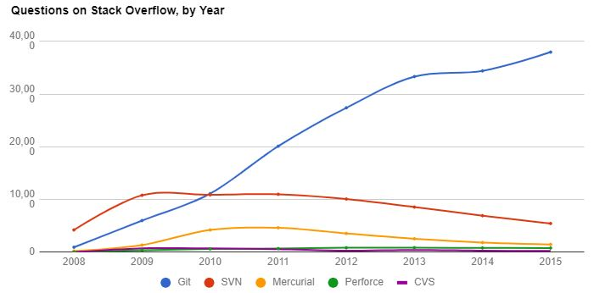



Git in the wild

Slide 5
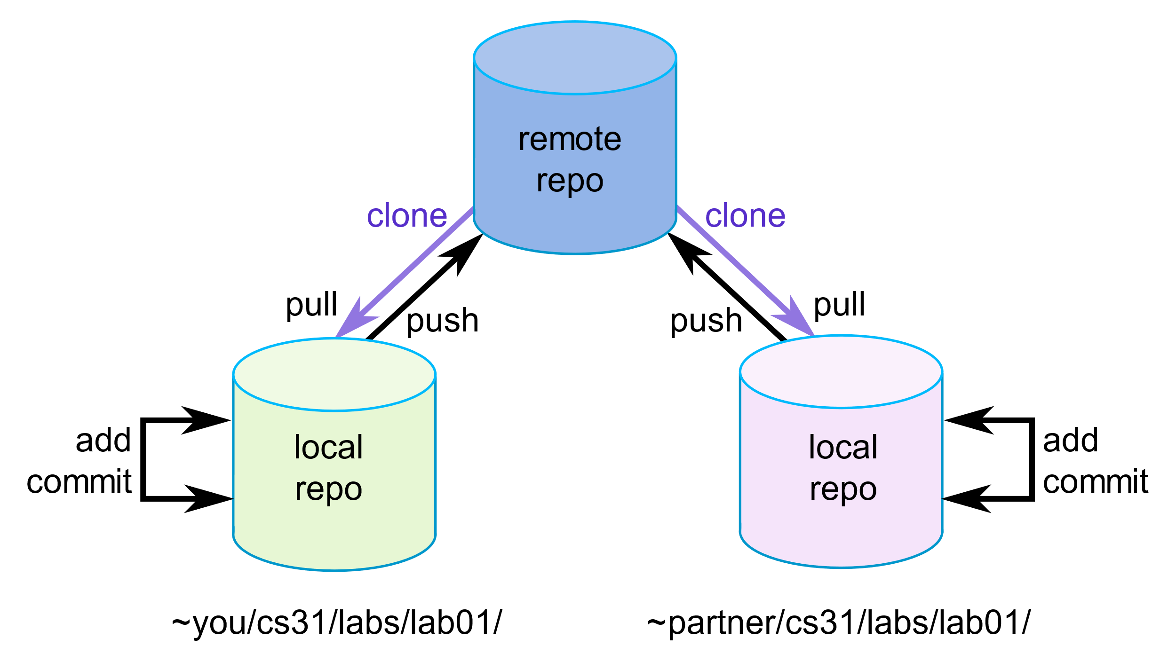
Activity #1 Git Clone

Slide 6
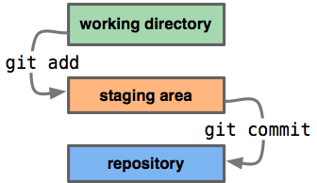
Activity #2 Git Add, Commit

Slide 7
Activity #2 Git Add, Commit
Create a new file <username>.txt
Modify the file by writing into it
Stage the new file in GitKraken
Create a new commit
Push the new commit

Slide 8
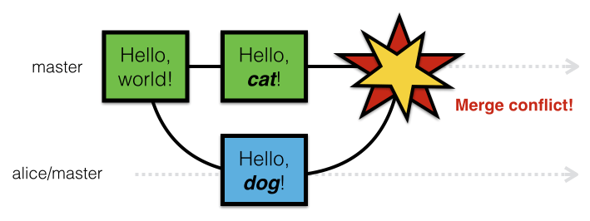
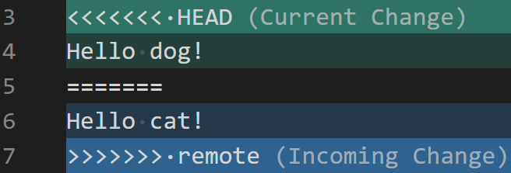
Activity #3 Git Conflict

Slide 9
Activity #3 Git Conflict
Open file conflict.txt
Modify the file by editing the first line
Stage and commit the changes
Git pull
Resolve conflict and finalise the pull operation

Slide 10

Homework
Add file what_we_learnt.txt
Add file what_we_want_to_learn.txt
Experiment with the folder .git

Slide 11
Useful links
Interactive visualisation of various git functions
https://learngitbranching.js.org/
Similar tutorials
https://www.tutorialspoint.com/git/index.htm
https://www.codecademy.com/learn/learn-git
Quick reference for git functions (cheat-sheet)
https://www.atlassian.com/git/tutorials/atlassian-git-cheatsheet
More advanced concepts
https://www.atlassian.com/git/tutorials/advanced-overview
https://www.toptal.com/software/trunk-based-development-git-flow

